Slide 1
White Box Testing
Prepared By Chala Urgessa

Slide 2
White Box Testing Introduction
Testing control structures of a procedural design.
Can derive test cases to ensure:
all independent paths are exercised at least once.
all logical decisions are exercised for both true and false paths.
all loops are executed at their boundaries and within operational bounds.
all internal data structures are exercised to ensure validity.

Slide 3
White Box Testing Introduction
Why do white box testing when black box testing is used to test conformance to requirements?
Logic errors and incorrect assumptions most likely to be made when coding for "special cases“. Need to ensure these execution paths are tested.
May find assumptions about execution paths incorrect, and so make design errors. White box testing can find these errors.
Typographical errors are random. Just as likely to be on an obscure logical path as on a mainstream path.

Slide 4
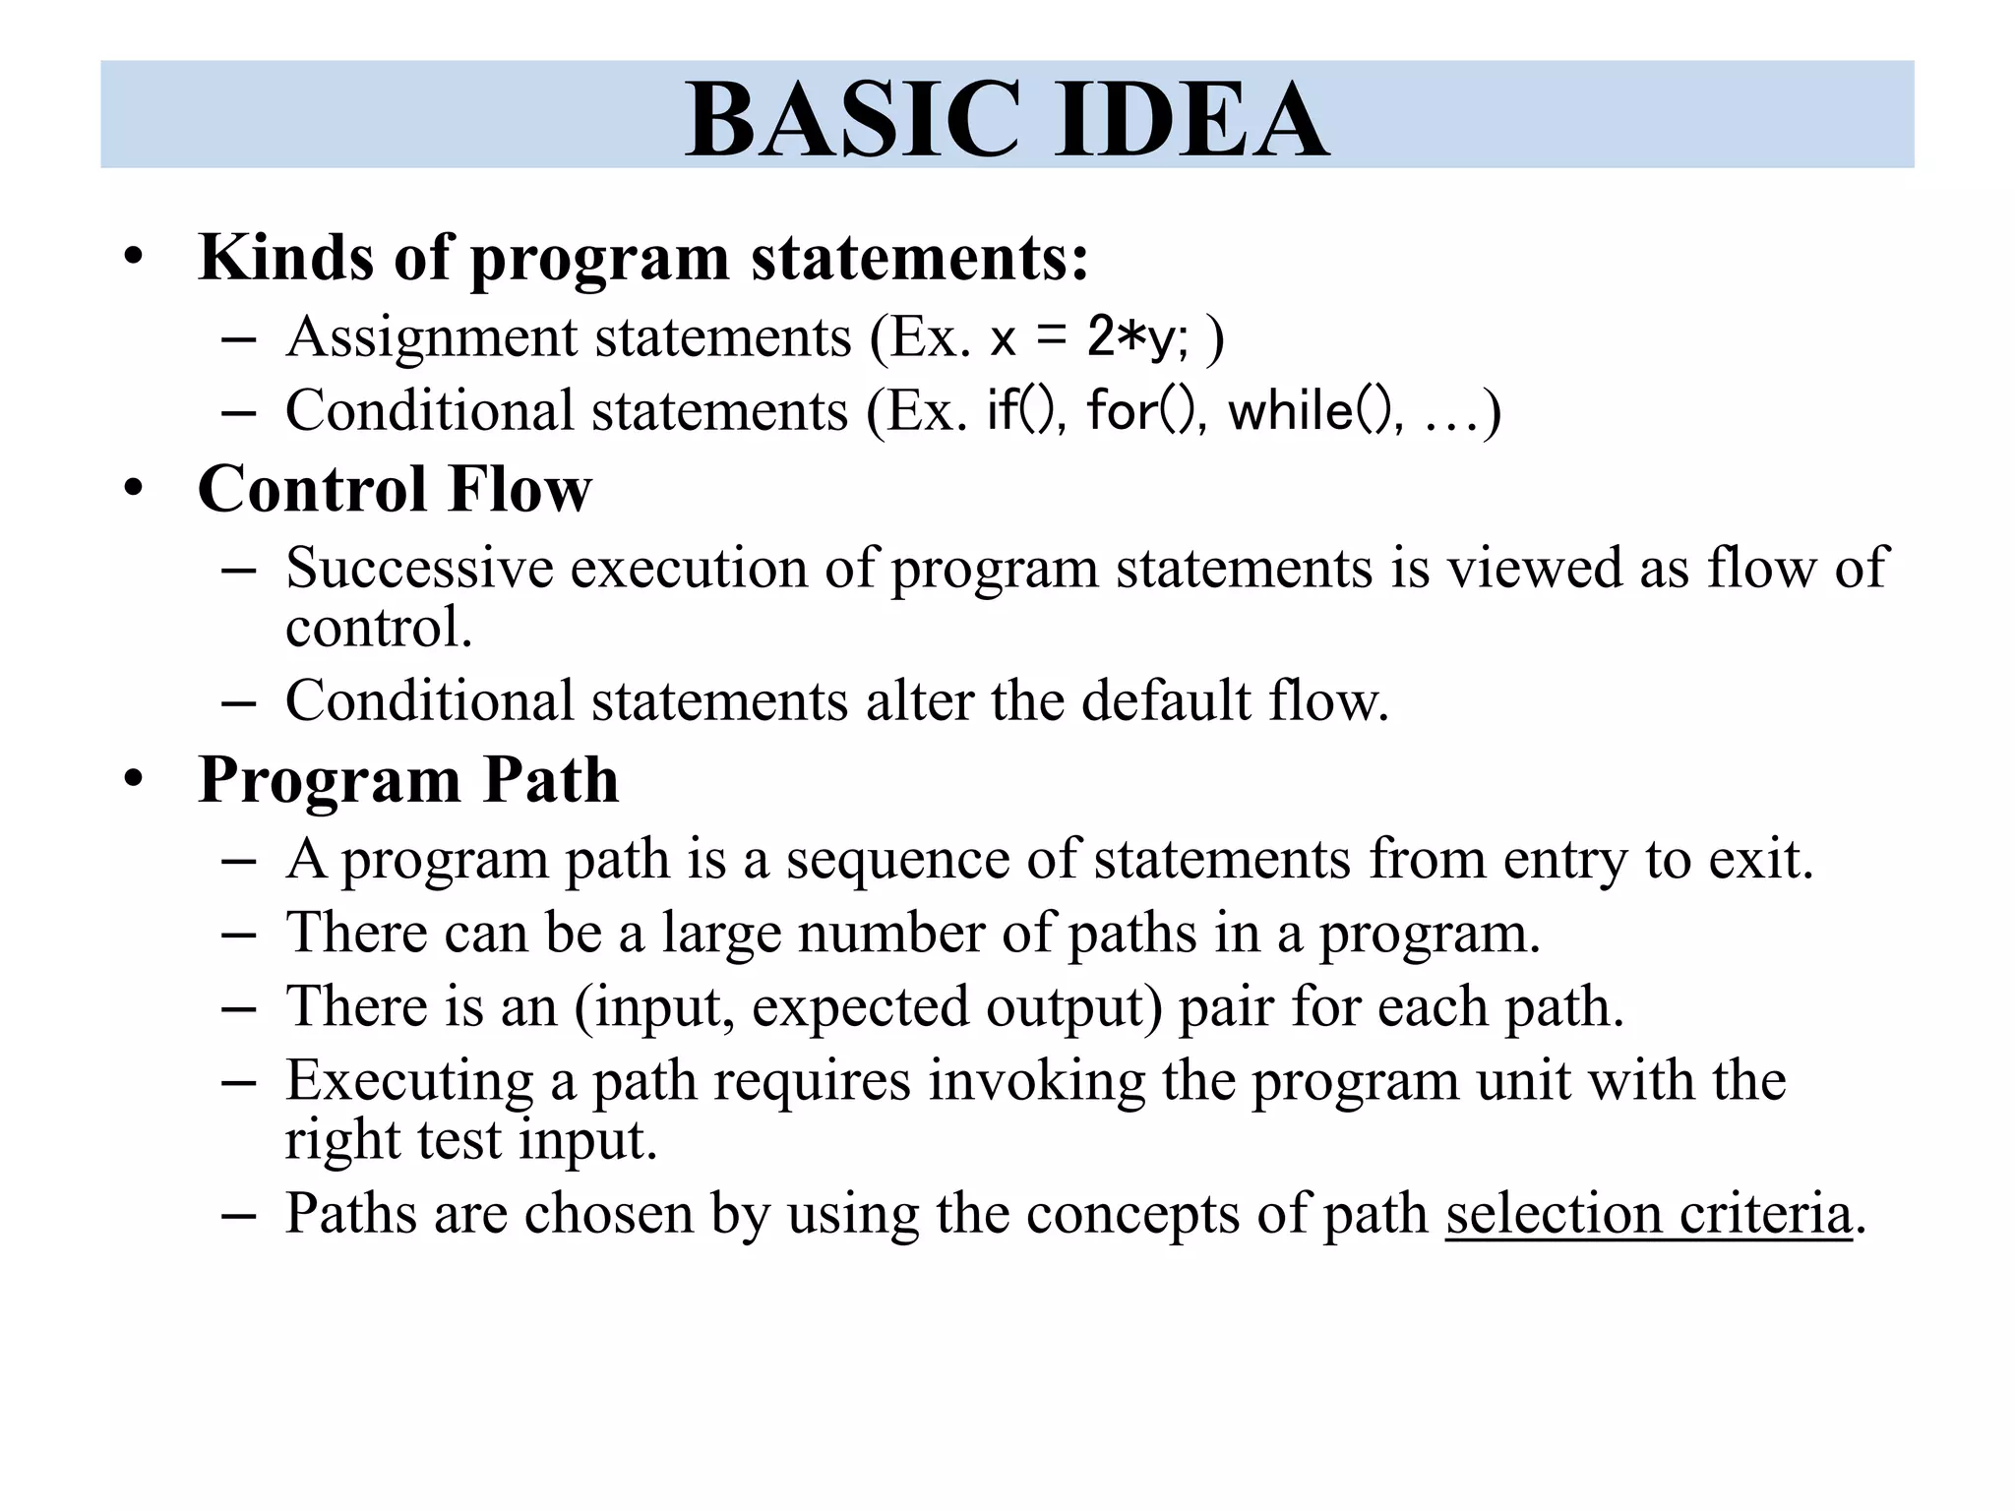

Slide 5
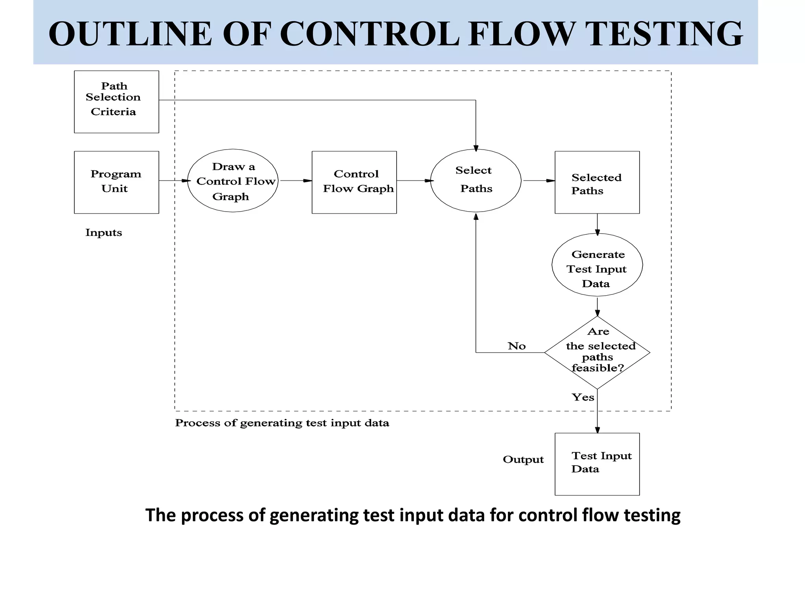

Slide 6
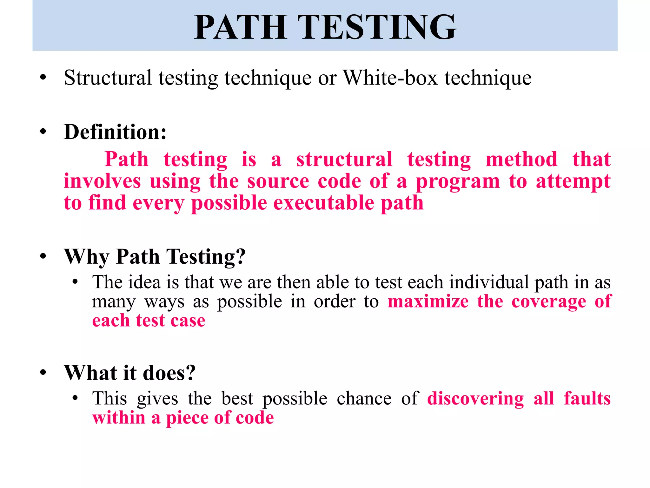

Slide 7
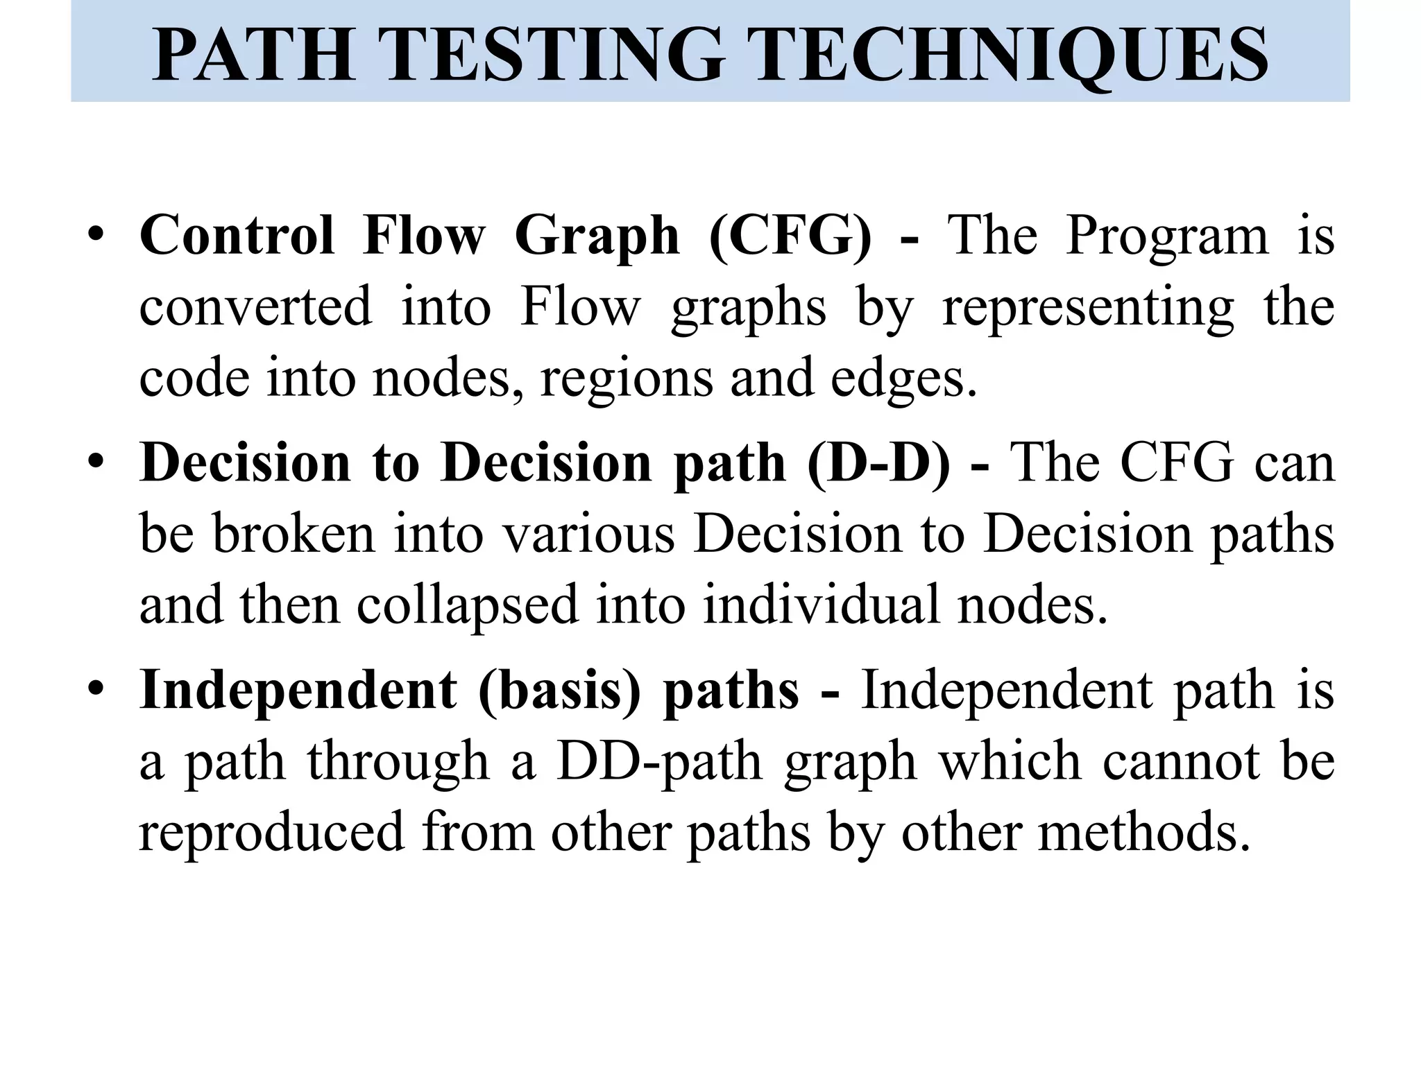

Slide 8
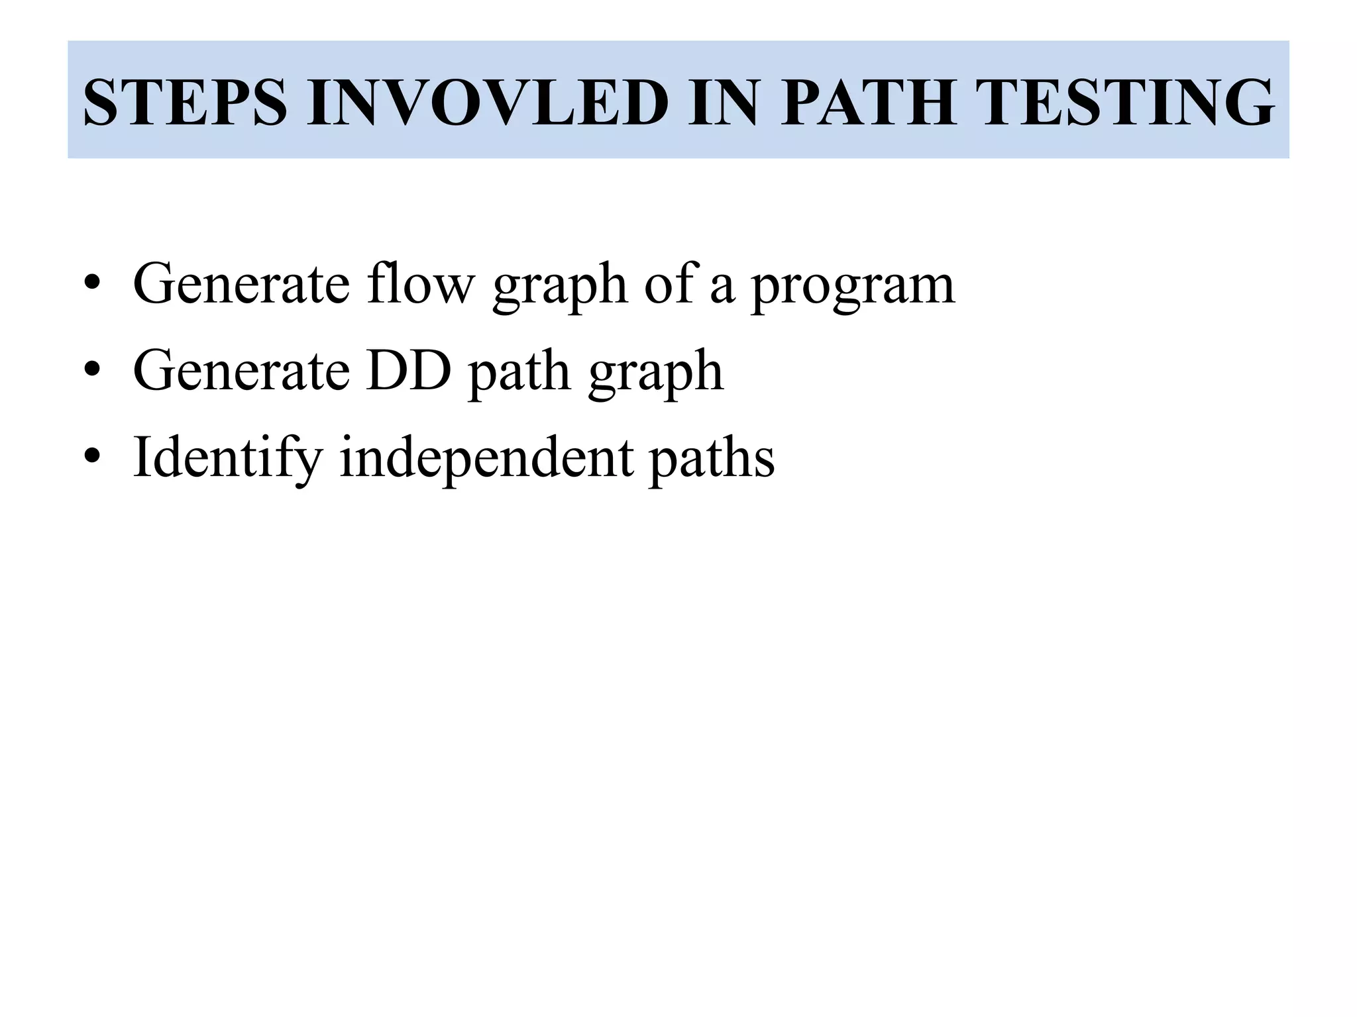

Slide 9
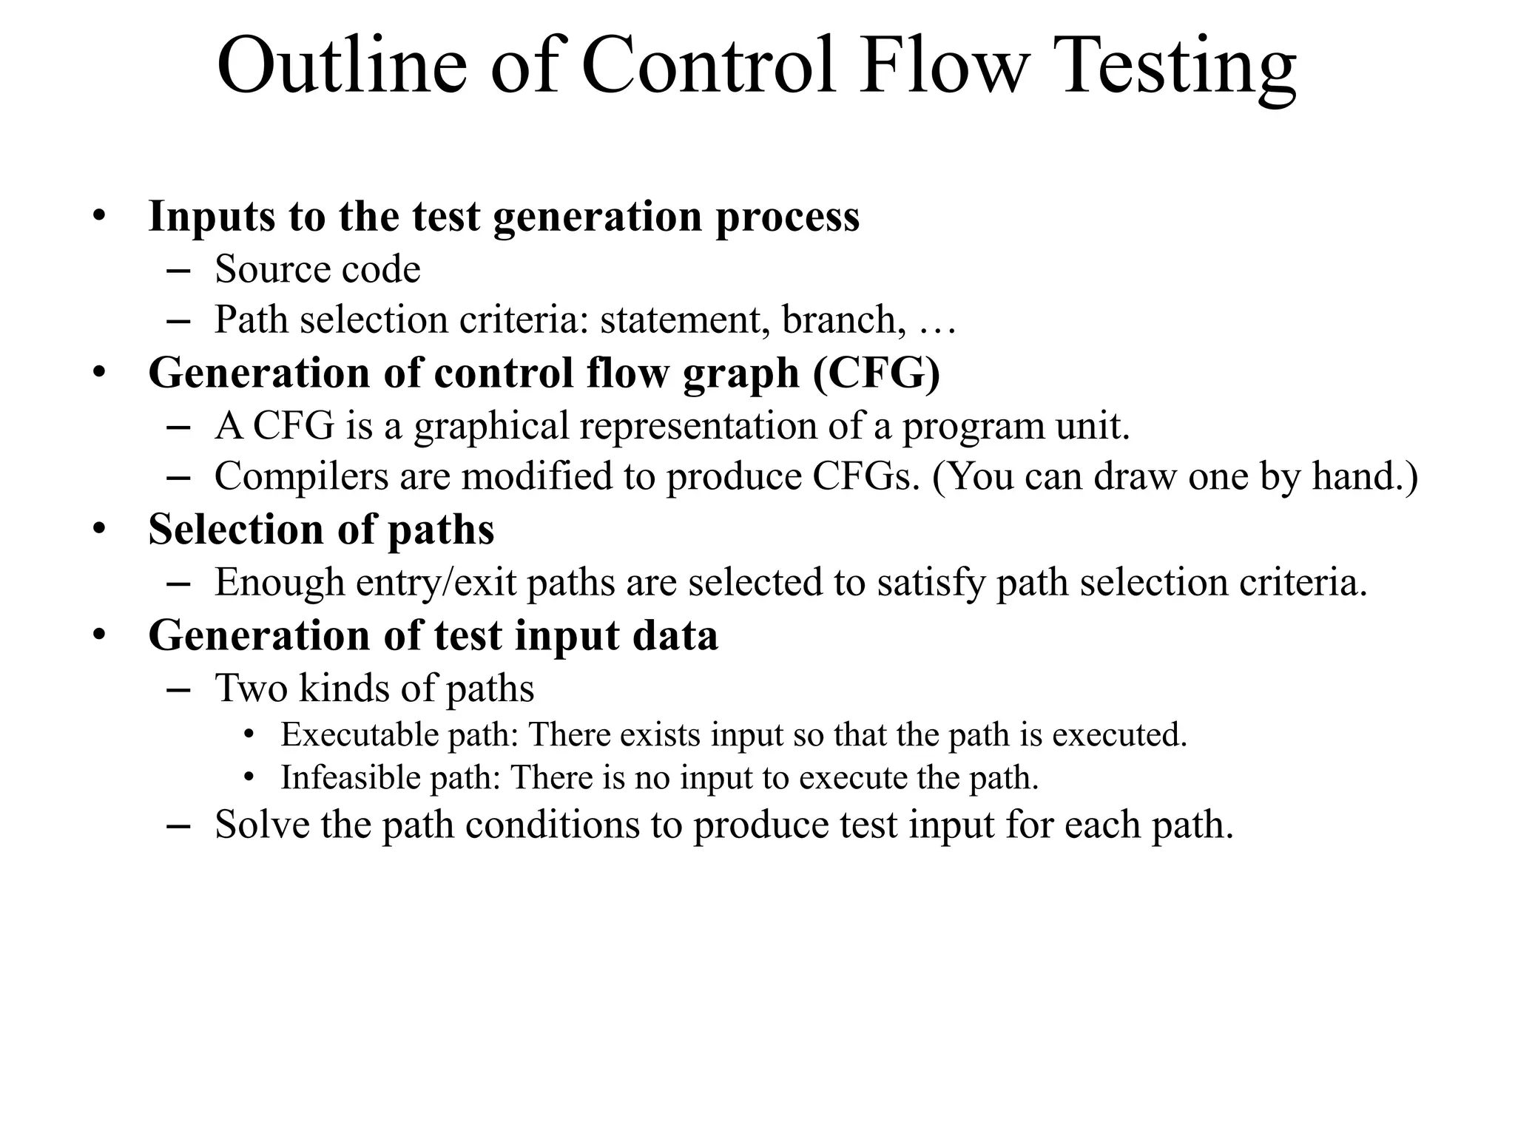

Slide 10
